Slide 1
Sampling Distributions

Slide 2
Outline
Parameters and statistics
Statistical estimation and the law of large numbers
Sampling distributions
The sampling distribution of the sample mean
The central limit theorem <Later>

Slide 3
Parameters and Statistics I
A parameter(population parameter)
  A number that describe the population
  Fixed but unknown
For example, the population mean is a parameter.

Slide 4
Parameters and Statistics II
A statistic (sample statistic)
  A number that describe a sample
  Known after we take a sample
  Change from sample to sample
  Used to estimate an unknown parameter
For example, the mean of the data from a sample is used to give information about the overall mean in the population from which that sample was drawn.

Slide 5
Example
A survey conducted by a research in art education found that, 17% of those surveyed, had taken one course in dance in their life.
Q: Is the number 73% (= 100%-17%) a statistic or a parameter?
Q: Is the unknown true percentage of American citizen that have taken at least one course in dance in their life a parameter or a statistic?

Slide 6
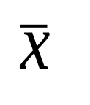
Statistical estimation & the law of large numbers
Random variables are used to estimate a population parameter. Because good samples are chosen randomly, statistic such as are random variables.
The probability of any outcome of a random phenomenon is the proportion of times the outcome will occur in the long run. Thus, we can describe the behavior of a sample statistics by a probability model that answers the question “What would happen if we do this many times?”
and
“What would happen if we take a big # of
observations ?”

Slide 7
Example 10.2 (page 251)
Here are the odor thresholds for ten randomly chosen subjects: 28 40 28 33 20 31 29 27 17 21, the mean is 27.4.Since SRS should represent the population, so that we expect that close to the mean of the population.
Q: Each sample of the same population will have a different mean , why is it a reasonable estimate of the population mean?

Slide 8
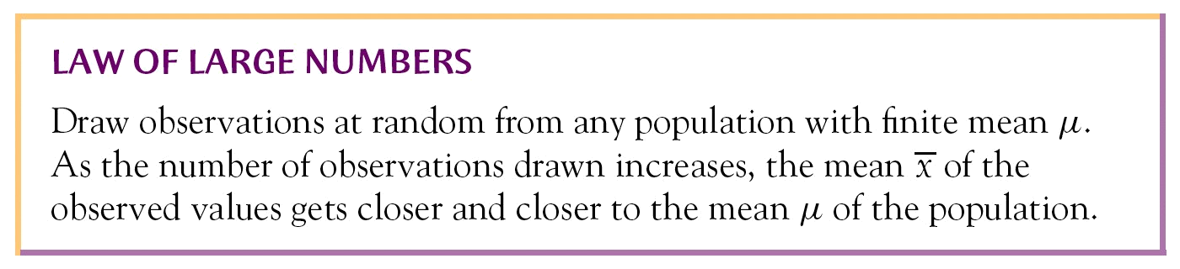
One answer is the Law of Large Number

Slide 9
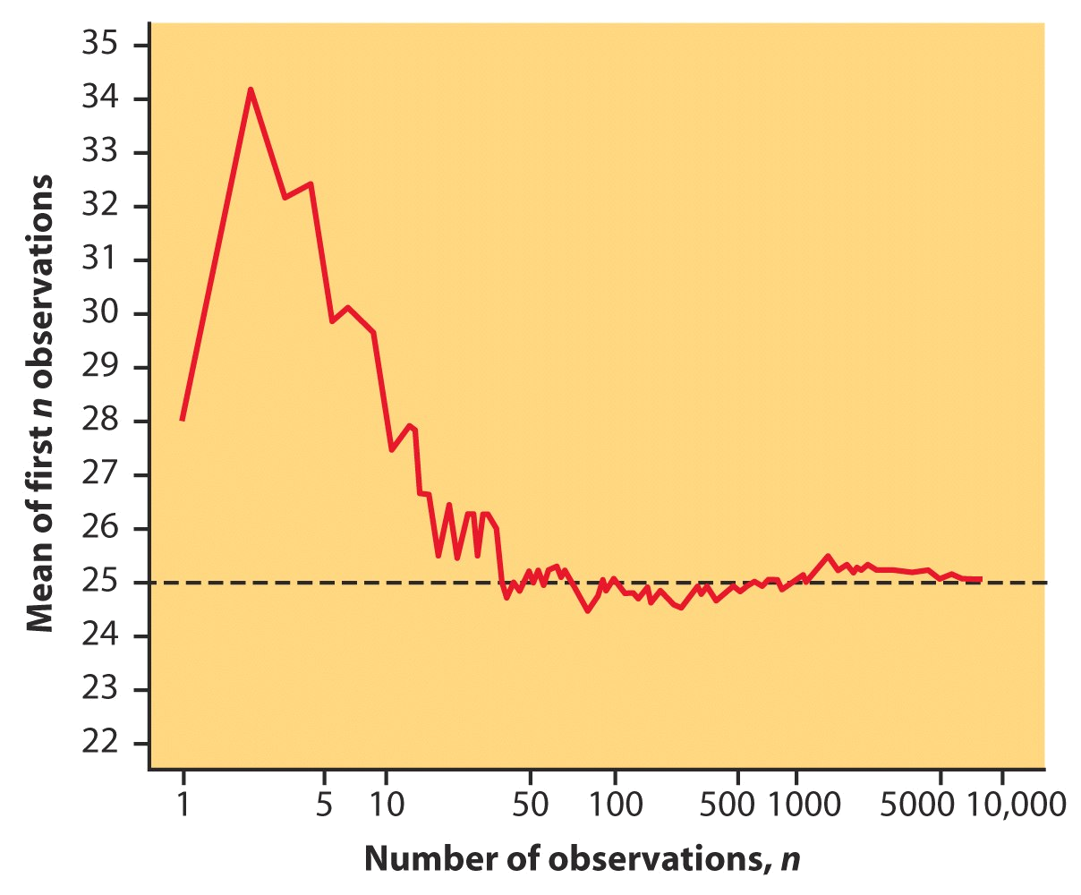
Example 10.3(P252): How sample means approach the population mean (μ=25).

Slide 10
Sampling distribution
The sampling distribution of a statistic(not parameter) is the distribution of values taken by the statistic (not parameter) in all possible samples of the same size from the same population.

Slide 11
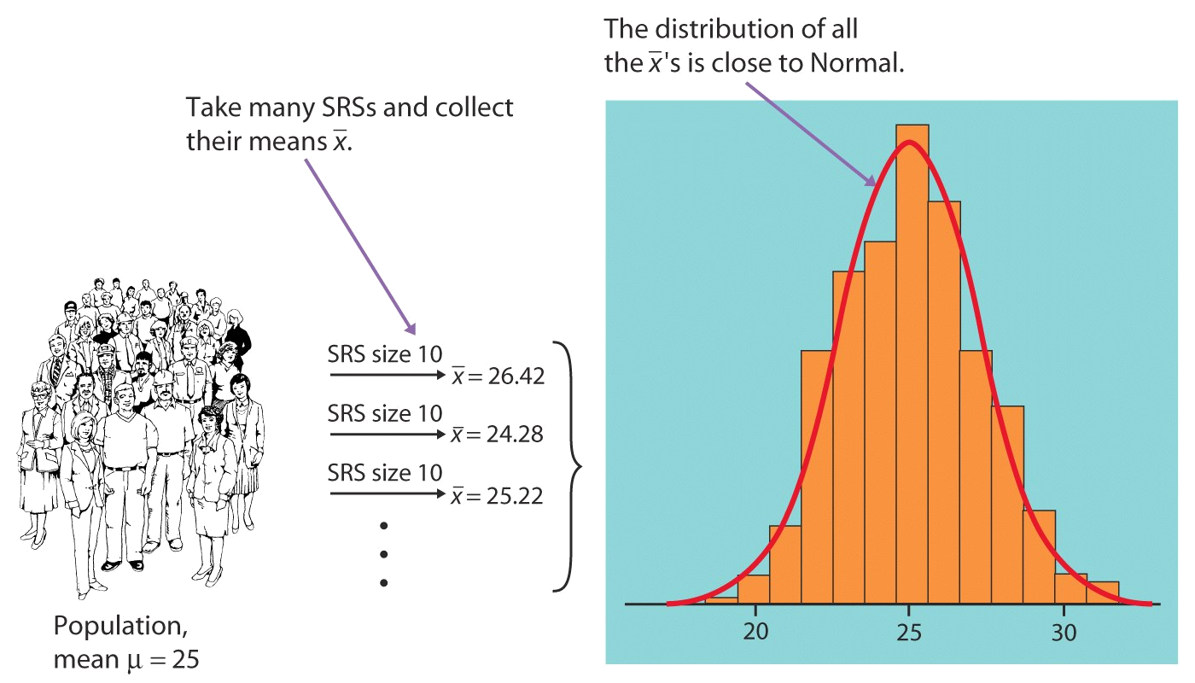
Example 10.4 (page 254)
- what would happen in many samples?

Slide 12
Recall Some Features of the Sampling Distribution
It will approximate a normal curve even if the population you started with does NOT look normal
Sampling distribution serves as a bridge between the sample and the population

Slide 13
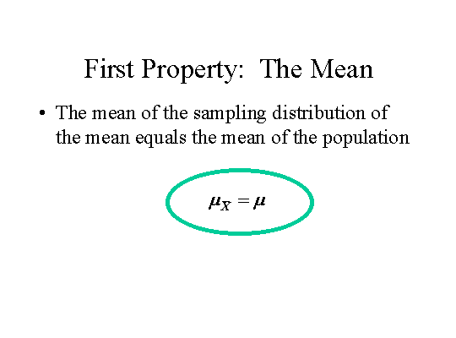
Mean of a sample mean

Slide 14
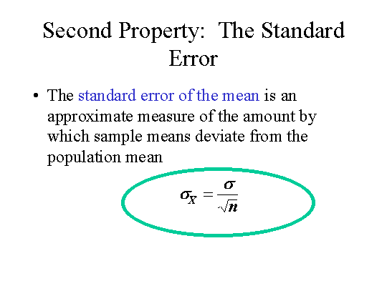
Standard Deviation of a sample mean

Slide 15
Third Property: Sample Size and the Standard Deviation
The larger the sample size, the smaller the standard deviation of the mean
Or
As n increases, the standard deviation of the mean decreases

Slide 16
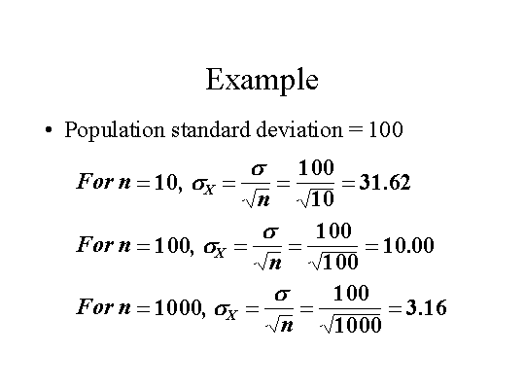

Slide 17
Sampling distribution of a sample mean
Definition: For a random variable x and a given sample size n, the distribution of the variable , that is the distribution of all possible sample means, is called the sampling distribution of the sample mean.

Slide 18

Sampling distribution of the sample mean
Case 1. Population follows Normal distribution
  Draw an SRS of size n from any population.
  Repeat sampling.
  Population follows a Normal distribution with mean µ and standard deviation σ.
  Sampling distribution of follows normal distribution as follows: N(µ, σ/√n ).

Slide 19
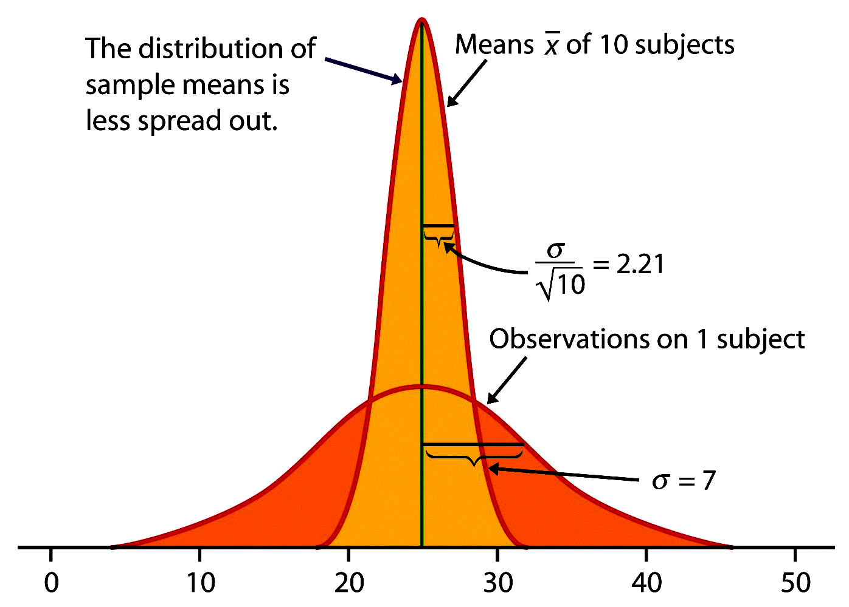
Example 10.5
(The population distribution follow a Normal distribution, then so does the sample mean)

Slide 21
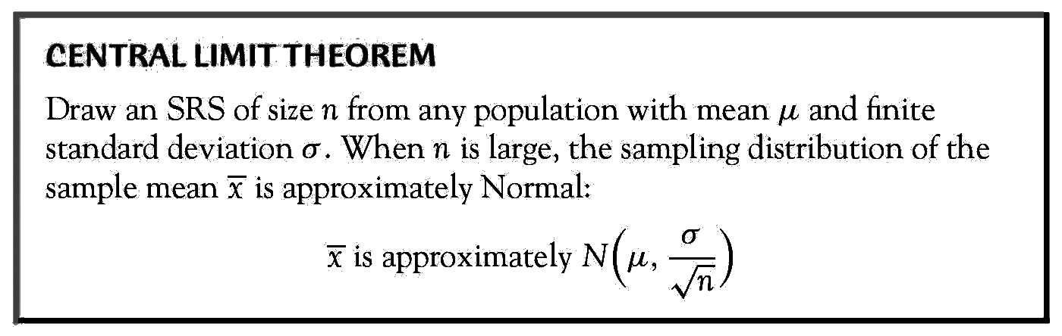
The central limit theorem
This theorem tells us:
Small samples: Shape of sampling distribution is less normal
Large sample: Shape of sampling distribution is more normal.

Slide 22
Sampling distribution of the sample mean
Case 2. Population follows any distribution (CLT: Central limit theorem)
  Draw an SRS of size n from any population.
  Repeat sampling.
  Population follows a distribution with mean µ and standard deviation σ.
  When n is large (n>=30), sampling dist of follows approximately Normal distribution as follows N(µ, σ/√n ).

Slide 23
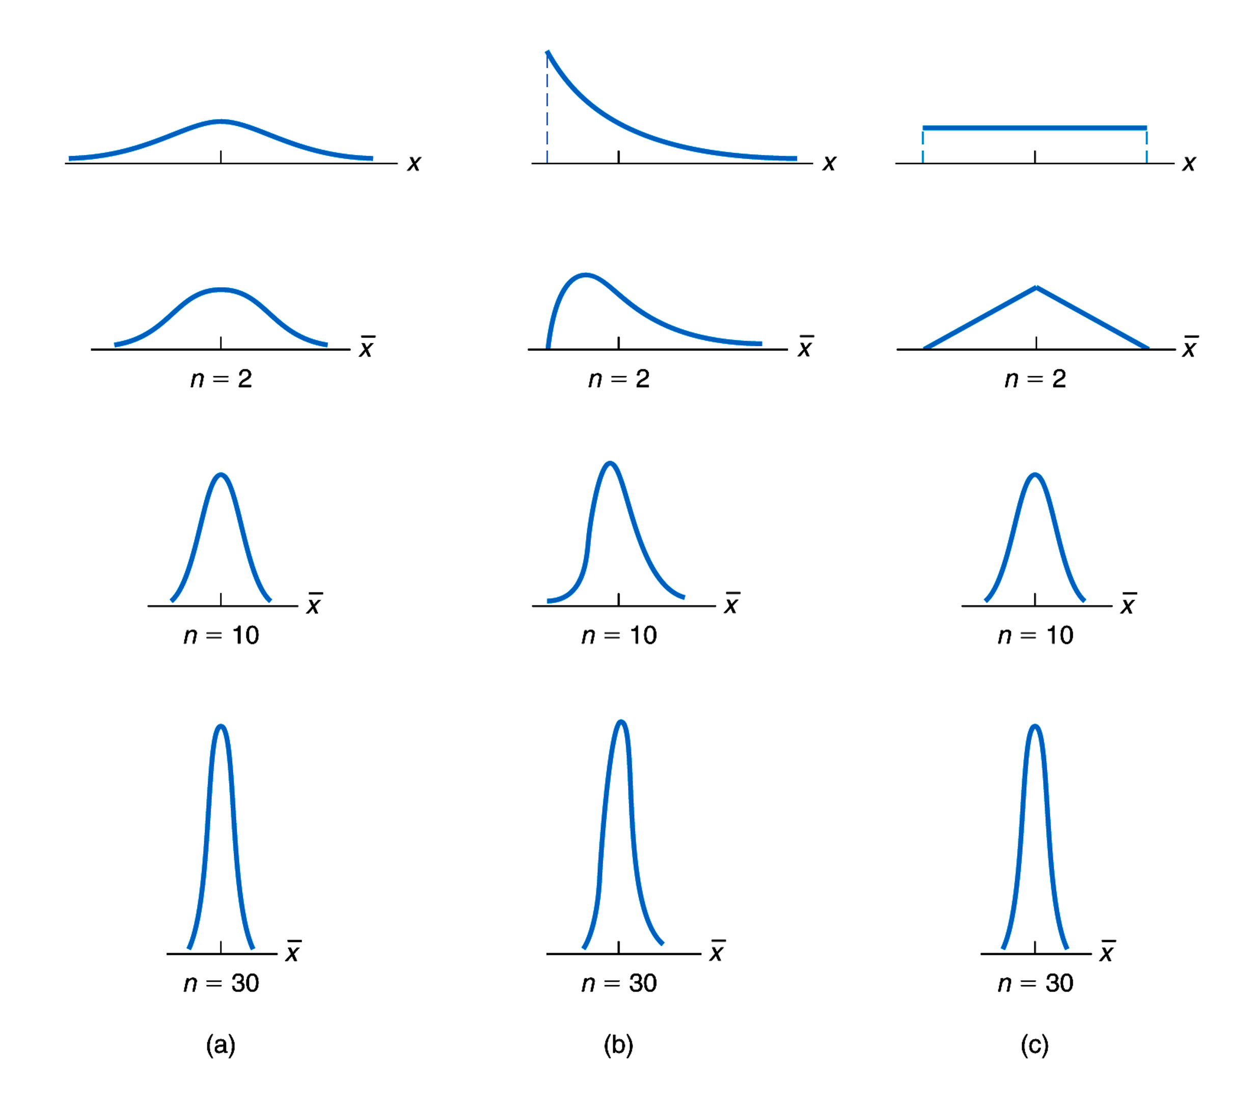
Sampling distributions for (a) normal, (b) reverse-J-shaped, and (c) uniform variables

Slide 25
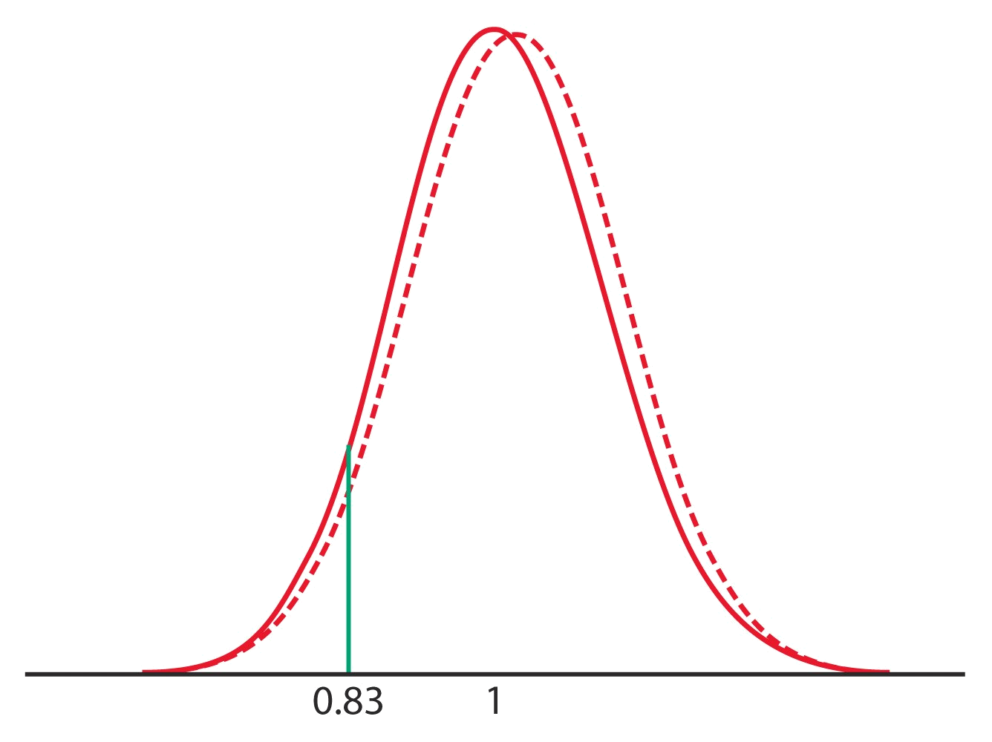
Example 10.7(CLT allows us to use Normal probability calculation to answer questions about the sample means)
σ
/
n

